Slide 1
Team 3 - Week 5 Update
Scott Birss
David Caplin
Troy Fine
Gabriel Ji
Aditya Sriwasth
Nelson Yeap

Slide 2
Accomplishments this week and Upcoming Goals:
This week
  PSoC sensors working
  Finish opencv environment setup
  Pi Camera working with opencv
Next week
  Low power modes for PSoC and Pi
APIs for Bluetooth Beacon to Phone, Pi to Pi communications via WIFI and Camera to Pi interface
Basic functionality of sensor and start spec sheets

Slide 3
PSoC Code almost done.
Sensor working
Communicates with Pi via GPIO pins
  One pin tells the Pi to wake up
  Another gives the status of the spot (low == not taken, high == taken)
Debugging low power mode.
  Currently using 20mA

Slide 4
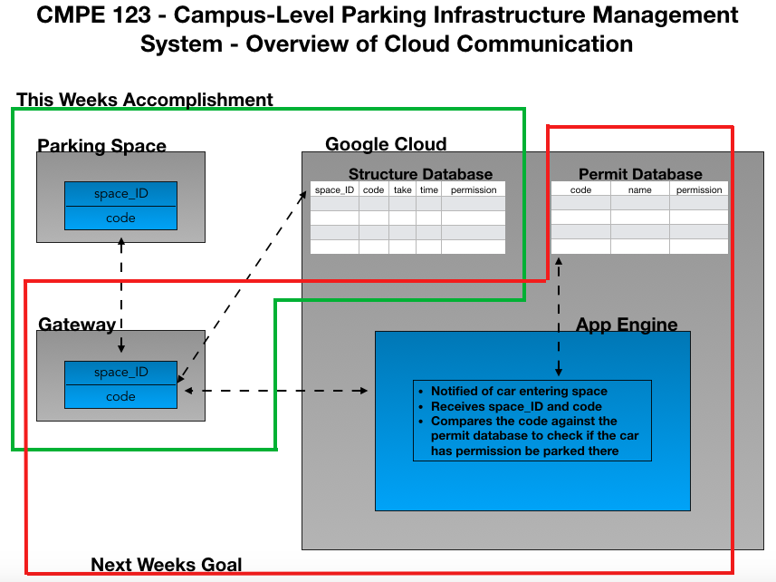

Slide 5
Mobile and Web Application Update
Created a basic template for the Web and Mobile App
  Written in html and css
    Has buttons to navigate pages for User interaction
Next Week’s goals
Establish Connection with the server
Updating information from the server

Slide 6
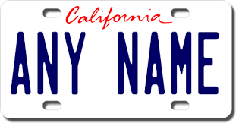
Raspberry & Computer Vision
Got the DVI to HDMI adapter to set up the Raspberry Pi in the Lab
Working on setting up the computer vision library on the Pi
Wake up signal
Raspberry Pi
(Computer Vision)
ANY NAME
Cloud

